Slide 1

Vegetation Control Plan 2023
Transportation and Economic Corridors

Slide 2

Background
In 2017 Transportation and Economic Corridors (TEC) collaborated with a variety of Ministries, Municipalities, and the provincial Agricultural Service Board to integrate a roadside vegetation management strategy that maintained public safety, maintained roadside integrity, was cost effective and would comply with the Weed Control Act.
The plan was implemented in 2017 and consisted of a yearly mowing and chemical spraying strategy to be used province wide.
In April of 2022, a program review of the 2017 vegetation management plan was requested to determine if the plan was still relevant by todays standards and financial climate.

Slide 3
Vegetation Control Plan Priorities
Safety is Transportation and Economic Corridors (TEC) top priority.
TEC’s maintenance funding is primarily based on meeting the requirements for safe operating conditions of the highway network.
Some work activities (such as pothole patching, crack sealing, culvert replacement, gravel highway maintenance) take precedence due to the severe repercussions to the highway network resulting from a failure.
Regarding vegetation control, TEC prioritizes activities that maintain safe sightlines and mitigating snow drifting.
TEC has a regulatory obligation to control noxious weeds and eliminate prohibited noxious weeds as per the Weed Control Act.
Funding and planning needs to be efficiently strategized through partnering with agriculture and municipalities to determine areas of priority and implementation of vegetation control measures.

Slide 4
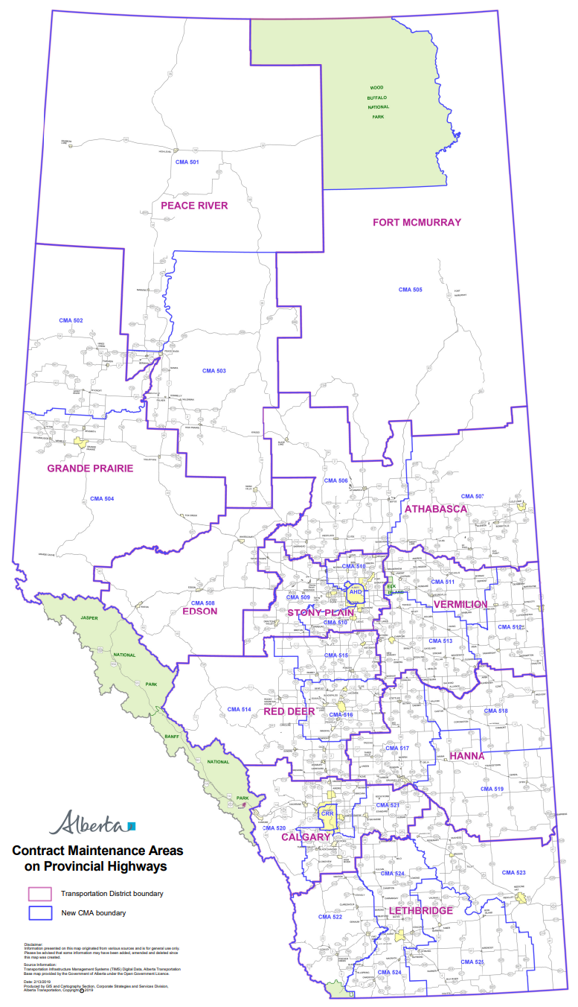
Current Considerations
TEC has an increased maintenance budget for 2023-2024.
High inflation has accounted for a portion of the maintenance budget increase.
Supply chain and labour shortages have:
  Increased lead times for procuring materials and equipment,
  Decreased work capacity for contractors, and,
  Increased costs for highway maintenance work.
Contract Maintenance Areas (CMA’s) do not have the same contracts and obligations across the province. This means:
  The contractual Level Of Service (LOS) may be different from one CMA to another.
  Planning and execution of work may require coordination with Highway Maintenance Contractors schedule.
  The minimum proposed Mowing and Chemical Control plans will be met or exceeded depending on the CMA.
  TEC is working towards standardizing all CMA’s to a similar contract as current contracts expire.
Fig. 1 – New CMA Boundaries
Notes:
Briefly explain what a CMA is.

Slide 5
Annual Proposed Mowing Plan
Highway | 2017 Mowing Plan | 2023 Minimum Mowing Plan
Class 1A | 1 Full Row, 1 Shoulder | 1 Full Row
Class 1B | ¼ Full Row, 1 Shoulder | ¼ Full Row, 3/4 Shoulder
Class 2 | ¼ Full Row, 1 Shoulder | ¼ Full Row, 3/4 Shoulder
Class 3 | ¼ Full Row, 1 Shoulder | ¼ Full Row, 3/4 Shoulder
Contracts will be funded appropriately to meet contractual obligations which will either meet or exceed the proposed Mowing Plan.
The cost of mulching to mowing per hectare is approximately 1,000% more expensive therefore, it is in TEC’s best interest to maintain at least the minimum mowing efforts.
Notes:
Reiterate that this is a MINIMUM level of service
Year to year depending on the work going on, CMA’s may be able to take on more mowing

Slide 6

Annual Proposed Chemical Control Plan
Highway | 2017 Chemical Control Plan | 2023 Minimum Chemical Control Plan
All Classes | 1 Full Row Spray every 4 years (25% of ROW Annually) 1% total hectares reactive spraying for noxious weed concerns | 1% total hectares reactive spot spraying
TEC revised the 2017 Chemical Control Plan to reduce the chemical footprint associated with Full ROW spraying which unnecessarily contributes to:
    Environmental damage,
    Loss of product crops, and,
    Increased chemical control costs.
Partnering with municipalities and agriculture fieldmen for work planning will be crucial.
Work planning meetings will be held with the respective municipalities and agriculture fieldmen to target spraying needs.
Noxious weeds will be treated as legislation requires.
Notes:
Again explain this is a minimum LOS
Blanket spraying was not an efficient method and irresponsible
We need the Ag fieldmen and municipalities to work plan with us and provide updates throughout the season as to where issues may be.
We will follow the Weed Act regulations and eradicate noxious weeds as they present themselves

Slide 7
Communication Plan
Coordination with respective agriculture fieldmen and/or other municipality representatives prior to growing season.
Spring meetings held to discuss work planning and identify locations of concern.
Work Plan should detail:
    Vegetation control strategy (locations and specific treatment for said locations),
    The time of year solutions should be implemented,
    Contractor work plan,
    Chemical type and rotation of chemicals to rectify problem areas, and,
    Estimated quantities required.
Through out summer seasons, agriculture fieldmen and MCI’s will be in continuous contact to ensure work plan is being followed and solutions are effective.
Partnering with Municipalities should be a continual process.

Slide 8
Summary
TEC has reviewed its Vegetation Control Plan and has outlined the following minimum strategy:
CMA’s across the province may encounter different LOS depending on their respective contractual obligations however, each area will either meet or exceed the minimum control plan outlined above.
Highway | 2023 Minimum Mowing Plan Proposal | 2023 Minimum Chemical Control Plan Proposal
Class 1A | 1 Full Row | 1% total hectares planned/reactive spraying annually
Class 1B | ¼ Full Row, 3/4 Shoulder
Class 2 | ¼ Full Row, 3/4 Shoulder
Class 3 | ¼ Full Row, 3/4 Shoulder
Notes:
Again reiterate this is a minimum plan and year to year a higher level of service may be seen

Slide 9
Closing
TEC is committed to public safety and will continue to prioritize improvements to highway infrastructure following this principal.
The proposed Vegetation Control Plan outlines a minimum level of service. There may an ability to complete additional work year to year.
TEC plans to review the Vegetation Control Plan every 4 years.
TEC strongly encourages collaboration and partnering with Municipalities and Agriculture.

Slide 10
Questions?

